Slide 1
Web Application Development ISCG7420 Introduction to Web Development
School of Computing, Electrical and Applied Technology

Slide 2
Outlines
Django Form
Django Authentication
Django Web Authentication
User Groups

Slide 3
Django Form
Built-in Field classes
CharField -> TextInput
ChoiceField -> Select
DateField -> DateInput
https://docs.djangoproject.com/en/4.0/ref/forms/fields/#built-in-field-classes

Slide 4
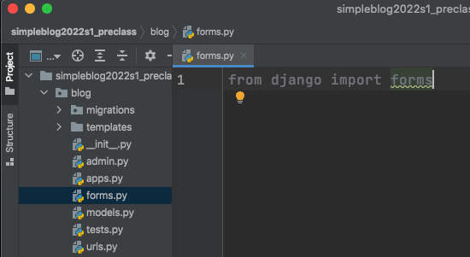
forms.py
Create a py file in your app folder

Slide 5
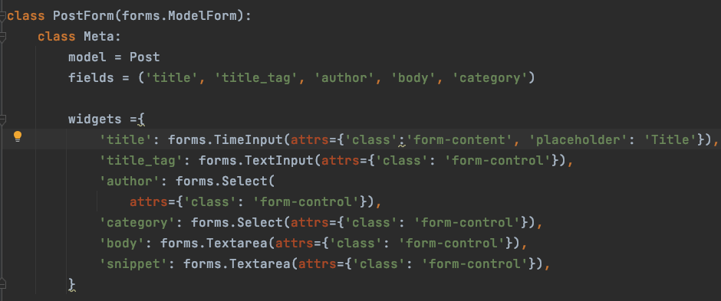
Example – Create View
I made a mistake on Model Post likes. Please change it to
null = True and blank = True

Slide 6
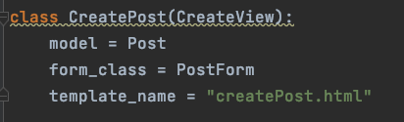
Use form in view

Slide 7
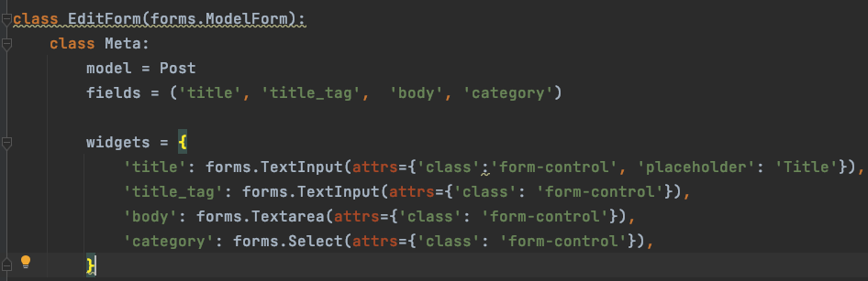
Practice Update View

Slide 8
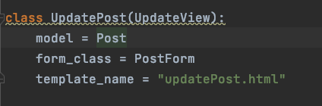
Use EditForm in View

Slide 9
Django authentication system
User objects
username
password
email
first_name
last_name

Slide 10
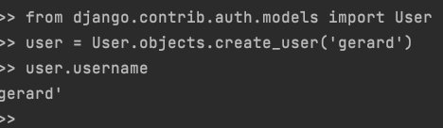
Create a user

Slide 11
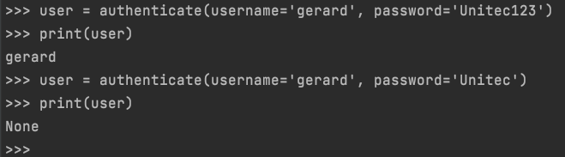
Authenticating users

Slide 12
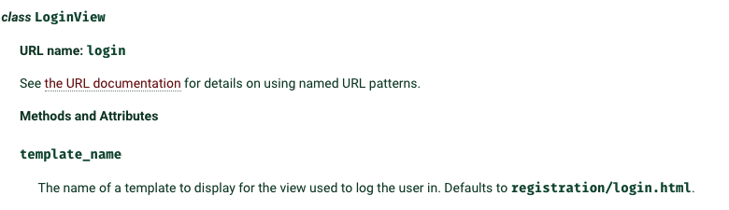
Django Web Authentication
https://docs.djangoproject.com/en/4.0/topics/auth/default/#module-django.contrib.auth.views
Read the document carefully

Slide 13
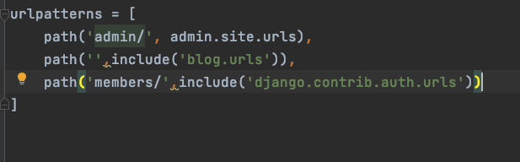
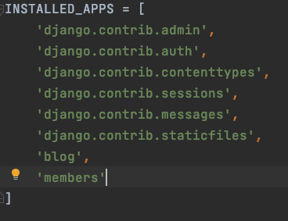
Create a new app
In urls
Settings.py

Slide 14
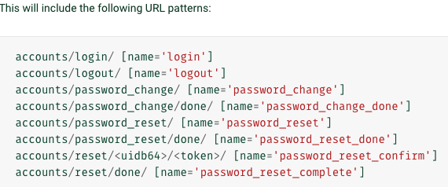
These views has been created

Slide 15
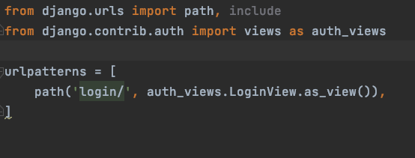

Login View
Settings.py

Slide 16
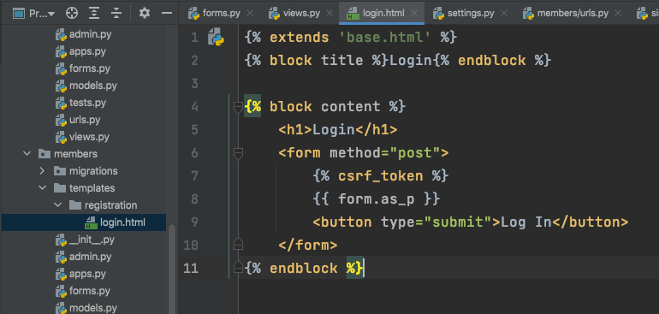
Create a template

Slide 17
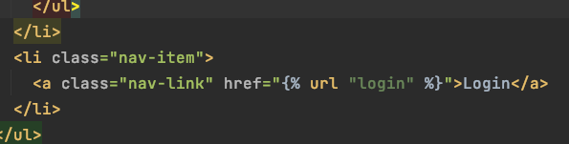
In base.html
Create an url for login

Slide 18
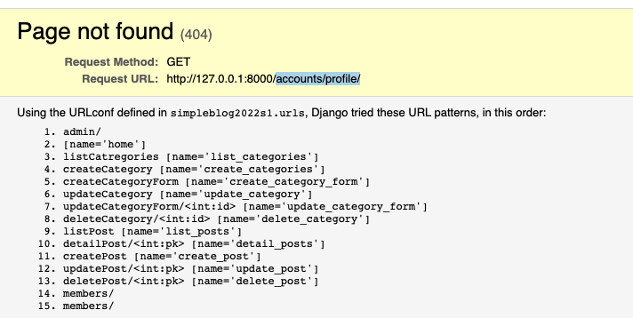
After login

Slide 19
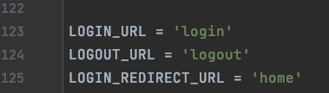
settings.py

Slide 20
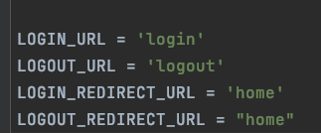

logout
settings.py
base.html

Slide 21
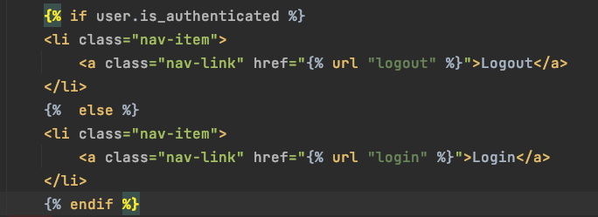
Login?
{% if user.is_authenticated %}
{% endif %}

Slide 22
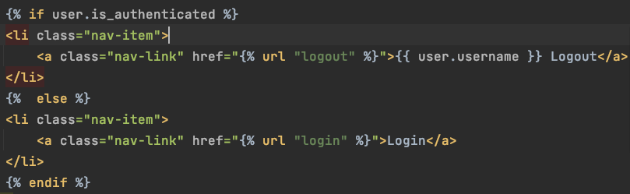
Who is the user?
{{ user.username }}

Slide 23
Exercise
In post list page,
Show post to owner only

Slide 24
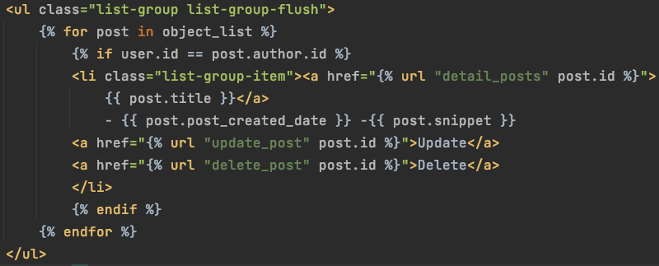
Answer

Slide 25

Add to group

Slide 26
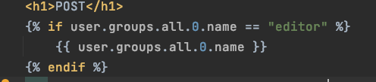
In a template

Slide 27
Exercise
Create a registration page,
Django registration
Portfolio
Add this user to group lecturer

